Slide 1
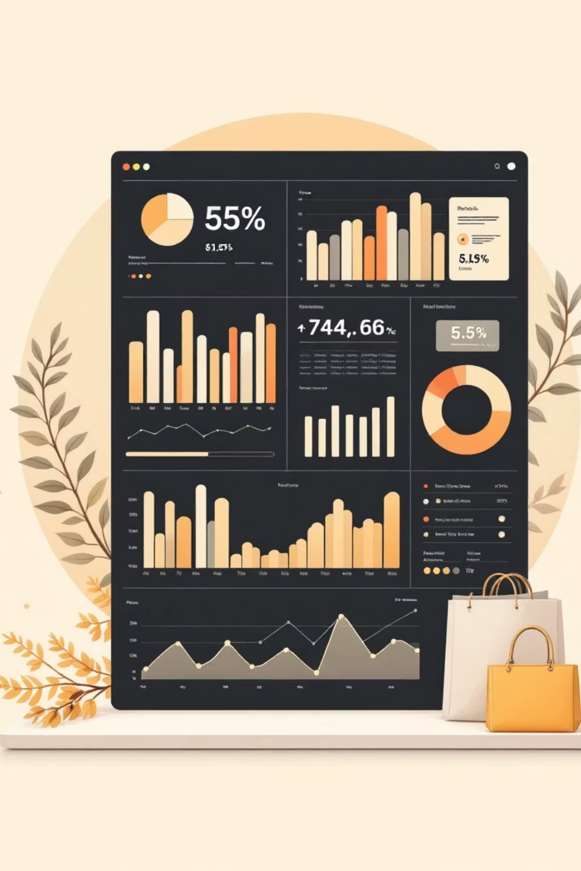
Customer Shopping Behavior Analysis
Uncovering insights from 3,900 purchases to guide strategic business decisions.

Slide 3

Dataset Overview & Preparation
Dataset Snapshot
Data Preparation Process
Data Loading
1
3,900
Imported dataset using pandas.
Total Purchases
Initial Exploration
2
18
Structure check and summary statistics.
Missing Data Handling
Comprehensive Data Columns
3
Imputed Review Rating with median values.
37
Feature Engineering
4
Missing Values (Review Rating Only)
Created age groups and purchase frequency metrics.
Database Integration
5
Connected to PostgreSQL for advanced analysis.

Slide 4
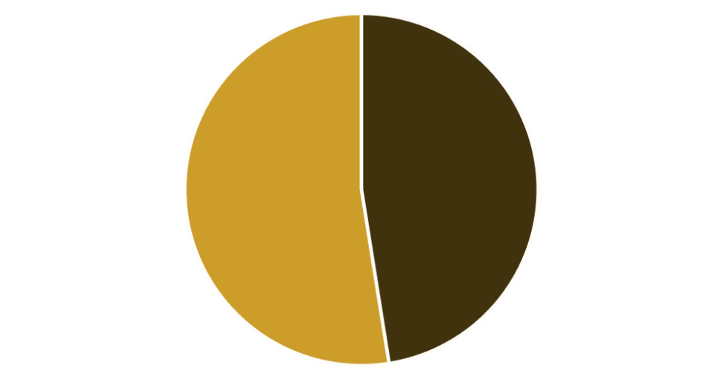


Revenue Insights: Gender & Discounts
Revenue by Gender Analysis
High-Value Discount Users
Female customers generate slightly higher total revenue than male customers.
Gender-based marketing strategies could optimize revenue streams.
Male vs. Female
Smart Shoppers
High spenders who maximize value with discounts.
Strategic Opportunity
Target premium customers with exclusive, personalized offers.

Slide 5




Strategic Recommendations & Customer Segmentation
Subscription Impact
Customer Segmentation
1
Loyal
15% - High value, frequent customers.
2
Returning
35% - Regular shoppers, potential for loyalty.
3
New
50% - First-time buyers, focus on conversion.
Strategy: Convert New to Returning, Returning to Loyal.
Higher Spend
Subscribers vs. Non-Subscribers
Revenue Share
Significant portion from subscriptions
Loyalty Rate
Increased repeat purchase frequency
Strategic Recommendations
Boost Subscriptions
Loyalty Programs
Promote exclusive benefits for subscribers to increase retention.
Reward repeat buyers to enhance customer lifetime value.
Targeted Marketing
Product Positioning
Focus campaigns on high-revenue segments and express shipping users.
Highlight top-rated products in all marketing and sales efforts.

